Slide 1
Lab 3 Datapath
Vinay Vazir
Jason Reynolds

Slide 2
DataPath

Slide 3
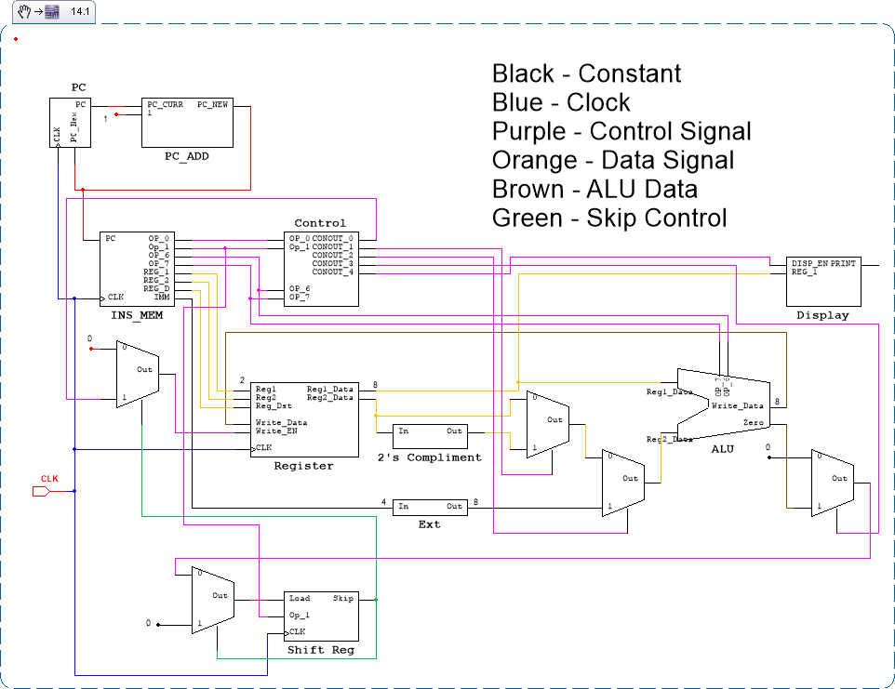

Slide 4
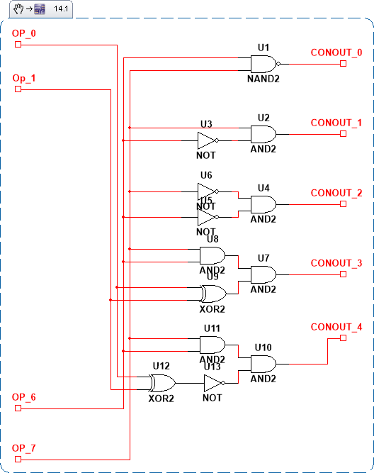
Control Signals

